Slide 1
Domain Modeling Made Functional
@ScottWlaschin
fsharpforfunandprofit.com
github.com/swlaschin/DmmfWorkshop_2hr

Slide 2
Functional programming: what is it good for?
Mathematical things only

Slide 3
Functional programming: what is it good for?
Mathematical things only
Interactive & collaborative domain modeling
Representing a domain model accurately

Slide 4
A perfect match!
Functional Programming
Domain Driven Design

Slide 5
Part I: Domain-Driven Design and Domain Modelling
Why is it important,
and why should you care?

Slide 6
Part I
Communication & Feedback
This isn't about coding, so why should you care?

Slide 7

Let's start with a comedy sketch (famous in UK)

Slide 8

Four candles?

Slide 9

What he thought he heard

Slide 10

What was actually asked for

Slide 11


Slide 12
Some 'ose?

Slide 13

What he thought he heard

Slide 14

What was actually asked for

Slide 15
Some 'p's?
Ok, just like those 'o's

Slide 16

What he thought he heard

Slide 17

What was actually asked for

Slide 18
What's the problem?
Misunderstanding the requirements
Acting on the requirements without getting feedback first
Most romantic comedies are based on the same premise.
Pro Tip: we don't want real life to be funny like this.

Slide 19

A café example
Customer: "Can I have some eggs?"
Waiter to chef: "Some eggs, please"
Russian chef: "Here you go…"

Slide 20

A café example
Waiter to chef: "Not fish eggs, chicken eggs "
Chef: "Ok, here you go…"

Slide 21

A café example
Waiter to chef: " No, cooked chicken eggs"
Chef: "Ok, this time I understand…"

Slide 22


A café example
Waiter to customer: "Here are your eggs"
Customer: "I wanted fried eggs"
Miscommunication

Slide 23

What's the solution?
A 200 page spec on how to cook a fried egg
Who thinks this will work?

Slide 24
This is not the solution!
We expect the chef to be a subject matter expert – an expert on making breakfast
A 200 page spec should not be needed!

Slide 25

What happens in real life?
2 fried eggs
A 3 word spec

Slide 26
Why does this tiny spec work?
Shared knowledge of the domain
Everyone is a "breakfast" expert!
Shared vocabulary
Everyone knows what "fried eggs" means.

Slide 27
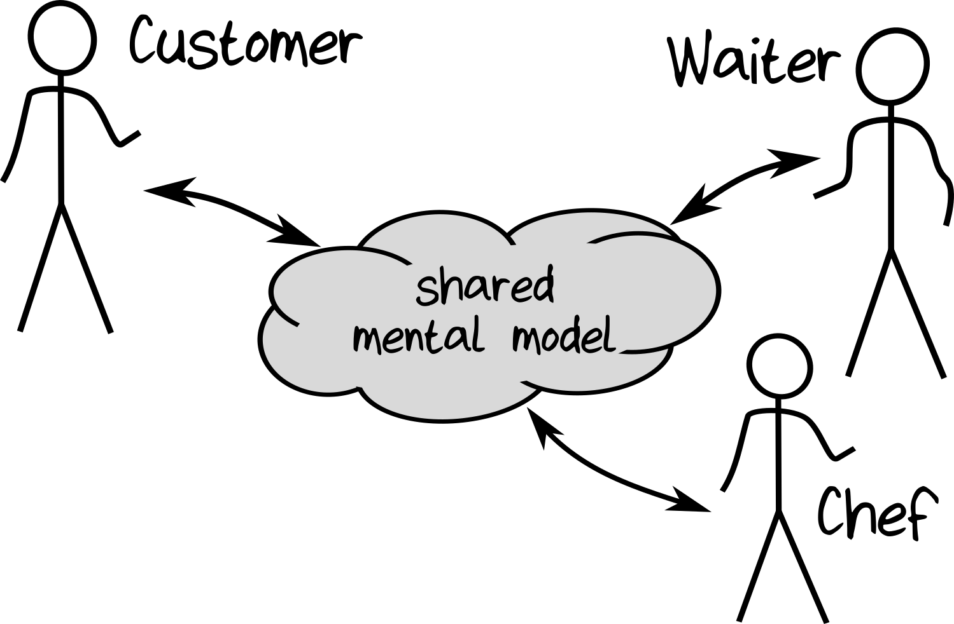

Slide 28
The importance of feedback
Fast feedback from the customer is important!
The customer can be unclear
The waiter can misunderstand
The chef can mess up

Slide 29
How long must a spec be?
Who here has a specialized hobby/interest?
If I asked you (an expert) to write an app for me, how big a spec would I need? Why?
or?

Slide 30
How long must a spec be?
If I asked a non-expert to write the same app for me, how big a spec would I need? Why?
or?

Slide 31
How long must a spec be?
Which of these two projects is more likely to succeed?
Written by the expert or non-expert?
or?

Slide 32
Why are experts better?
An expert will build the app better
And faster
With a smaller spec
And less confusion
Because…
Shared knowledge of the domain
Shared vocabulary

Slide 33
Part II
Domain Driven Design

Slide 34
What does all this have to do with software projects?
In my experience, most projects fail because:
Misunderstanding requirements, or
Going in the wrong direction, or
Starting off in the right direction but veering off course

Slide 35
What's the ideal software development process?
Build a shared mental model
Become an "expert"
Means a smaller spec
Less misunderstanding
And have frequent feedback
Make sure you are going in the right direction
No point going fast in the wrong direction!
Do a course correction if goals change

Slide 36
The software development process
Process
Input
Output

Slide 37
The software development process
Coding & testing
Process
Input
Output
Developers love to focus on this

Slide 38
The software development process
Process
Input
Output
Garbage in Garbage out

Slide 39
The software development process
Design
Process
Input
Output
This talk
(reduce) Garbage in (reduced) Garbage out

Slide 40
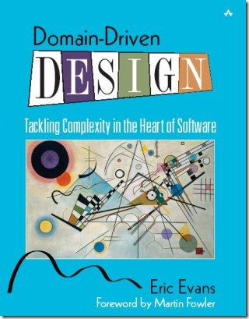
"Focus on the domain and domain logic rather than technology" -- Eric Evans

Slide 41

Or read the first 2 chapters of my book!

Slide 42
Why Domain-Driven Design?

Slide 43
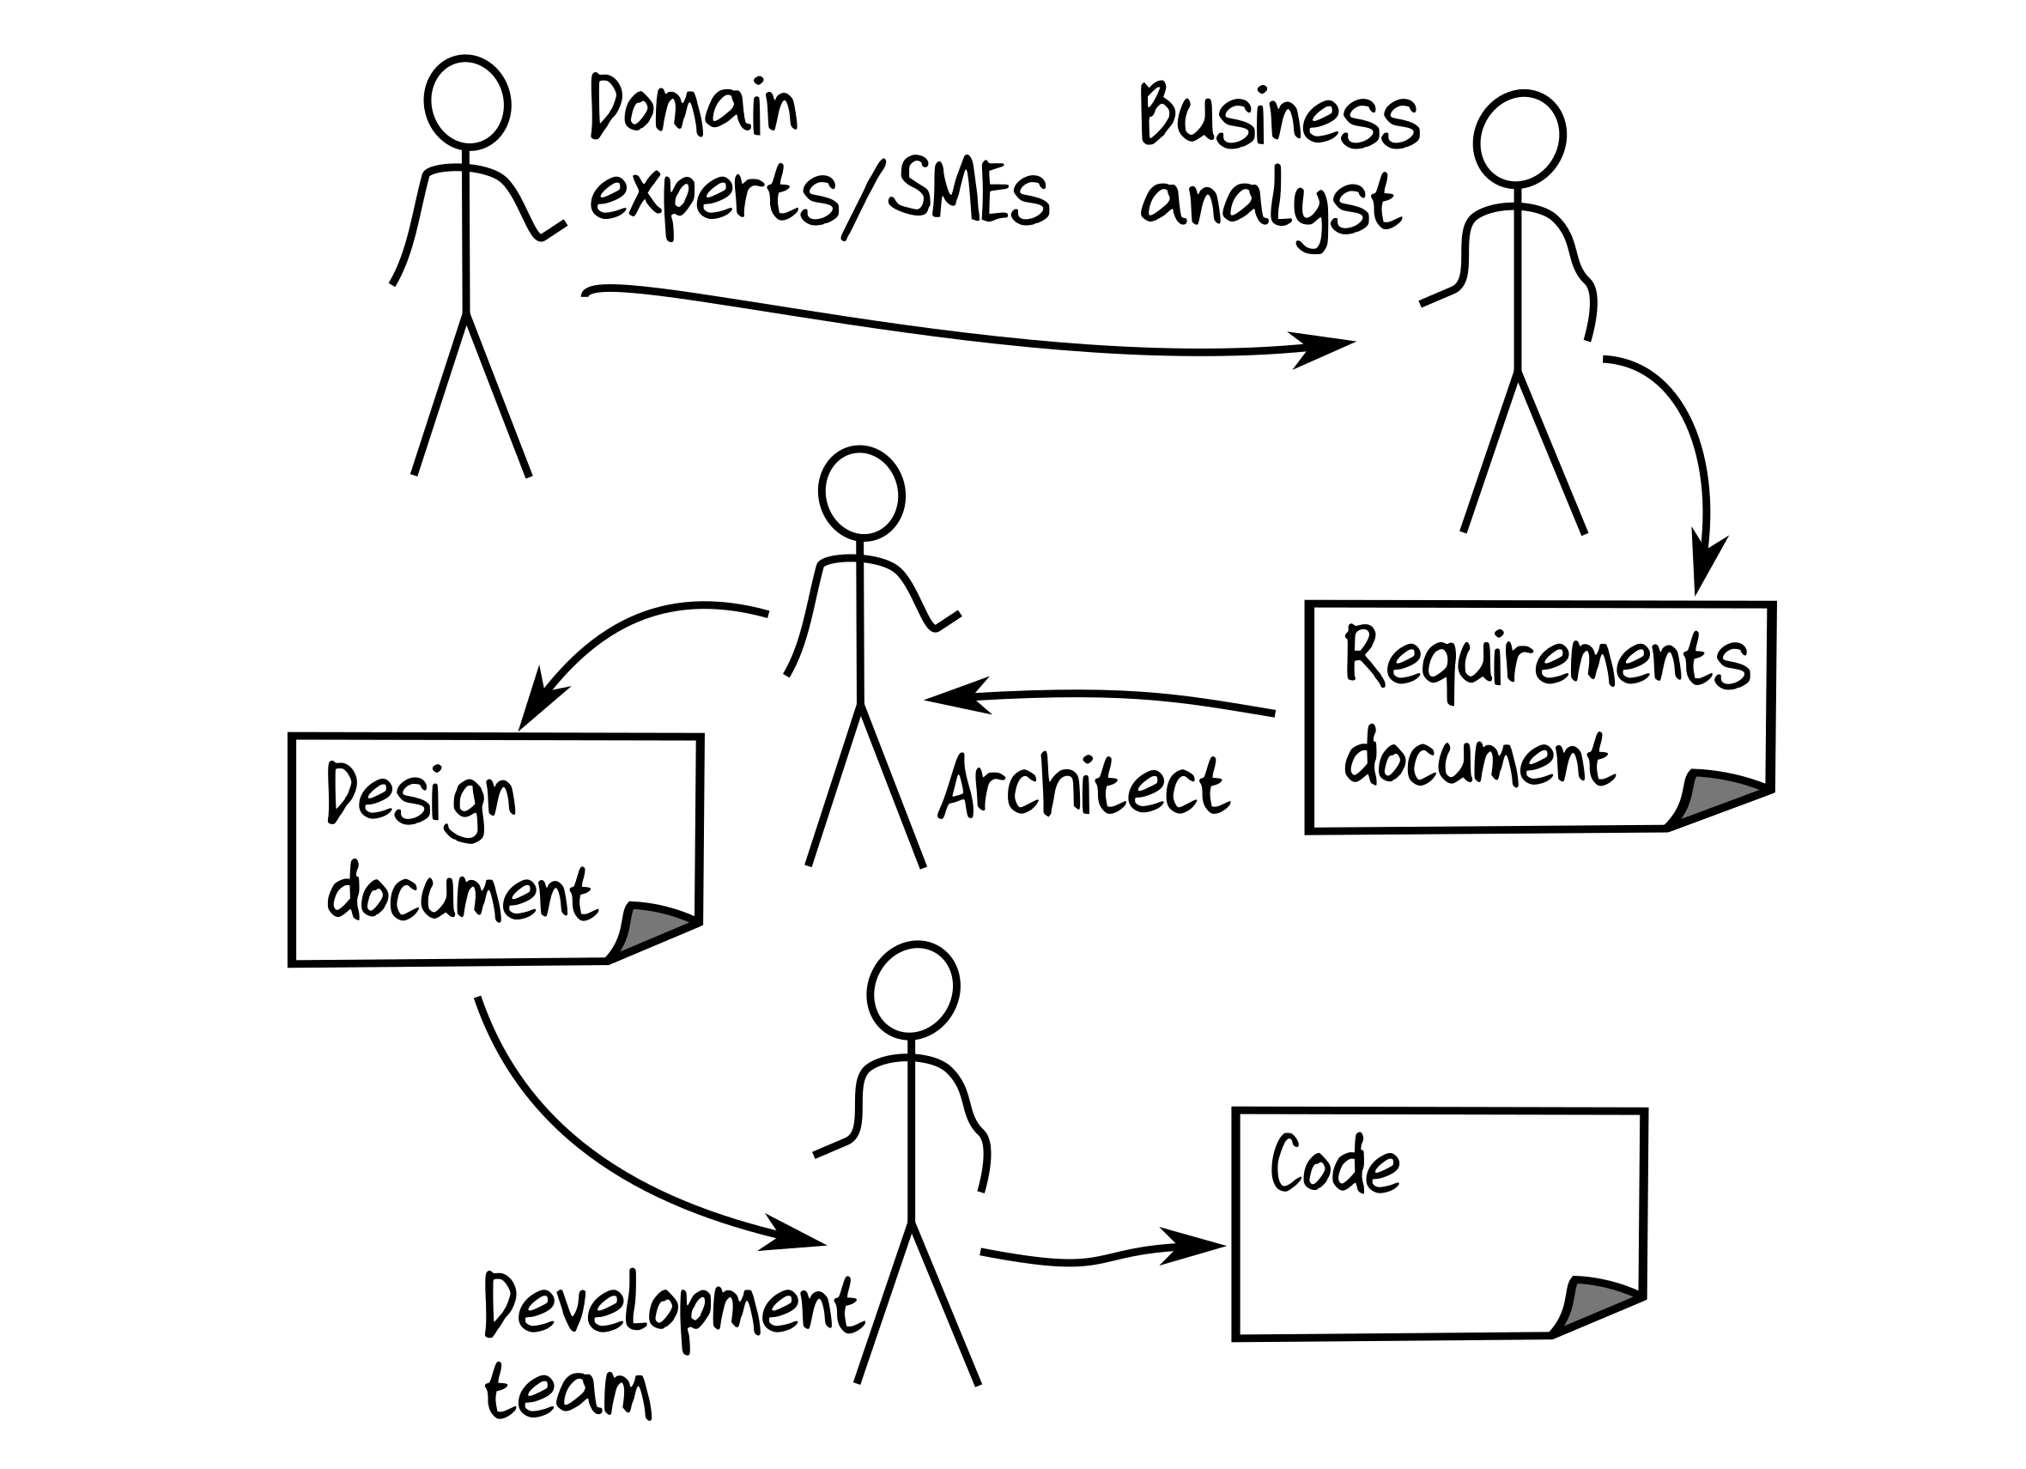
Waterfall
✗
No shared model
No feedback
Like a bad children's game…

Slide 44
Interlude: Waterfall development video

Slide 45


Warning: It's the developer's understanding of the domain that gets deployed to production!

Slide 46
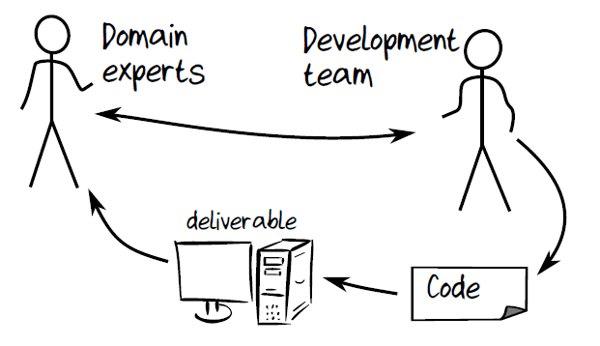
Agile
Frequent deliverables
Focus on feedback is good...

Slide 47
Agile
But code is still a "translation"

Slide 48
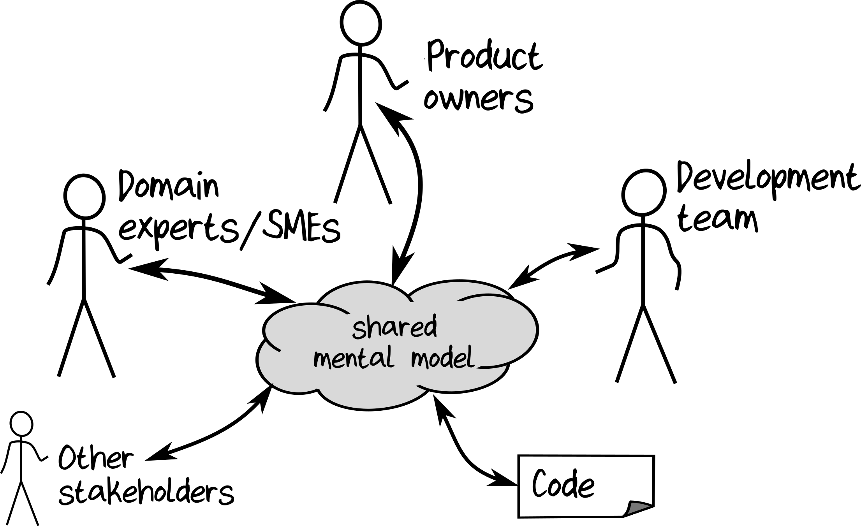
Domain-Driven Design
✓
shared language shared concepts

Slide 49
shared language shared concepts
Domain model == code == documentation

Slide 50
How can we do design right?
Agile contribution:
Rapid feedback during design
DDD contribution:
Stakeholders have a shared mental model
…which is also represented in the code

Slide 51
Can you really make code represent the domain?

Slide 52
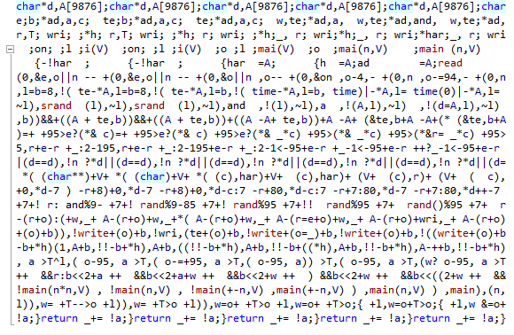
What non-developers think source code looks like
and some C developers!

Slide 53
What DDD source code should look like
module CardGame =
type Suit = Club | Diamond | Spade | Heart
type Rank = Two | Three | Four | Five | Six | Seven | Eight
| Nine | Ten | Jack | Queen | King
type Card = Suit * Rank
type Hand = Card list
type Deck = Card list
type Player = {Name:string; Hand:Hand}
type Game = {Deck:Deck; Players: Player list}
type Deal = Deck –› (Deck * Card)
type PickupCard = (Hand * Card) –› Hand
Shared language
Even if you don't know F#, you have an idea of what the important concepts are

Slide 54
'|' means a choice -- pick one from the list
module CardGame =
type Suit = Club | Diamond | Spade | Heart
type Rank = Two | Three | Four | Five | Six | Seven | Eight
| Nine | Ten | Jack | Queen | King
type Card = Suit * Rank
type Hand = Card list
type Deck = Card list
type Player = {Name:string; Hand:Hand}
type Game = {Deck:Deck; Players: Player list}
type Deal = Deck –› (Deck * Card)
type PickupCard = (Hand * Card) –› Hand
* means a pair. Choose one from each type
list type is built in
X -> Y means a workflow - input of X - output of Y

Slide 55
Modeling an action with a function
remaining
Deck with card missing
original
Deck
Deal
Card on table
type Deal = Deck -> (Deck * Card)
Input
Output

Slide 56
Modeling an action with a function
original
Hand
Pickup Card
updated
Hand with card added
Card on table
type PickupCard = (Hand * Card) –> Hand
Input
Output

Slide 57
Do you think this is a reasonable amount of code to write for this domain?
module CardGame =
type Suit = Club | Diamond | Spade | Heart
type Rank = Two | Three | Four | Five | Six | Seven | Eight
| Nine | Ten | Jack | Queen | King
type Card = Suit * Rank
type Hand = Card list
type Deck = Card list
type Player = { Name:string; Hand:Hand }
type Game = { Deck:Deck; Players: Player list }
type Deal = Deck –› (Deck * Card)
type PickupCard = (Hand * Card) –› Hand
The whole domain fits on one page!

Slide 58
Do you think a non-programmer could understand this?
module CardGame =
type Suit = Club | Diamond | Spade | Heart
type Rank = Two | Three | Four | Five | Six | Seven | Eight
| Nine | Ten | Jack | Queen | King
type Card = Suit * Rank
type Hand = Card list
type Deck = Card list
type Player = { Name:string; Hand:Hand }
type Game = { Deck:Deck; Players: Player list }
type Deal = Deck –› (Deck * Card)
type PickupCard = (Hand * Card) –› Hand
Real comment I heard: "Where's the code?"

Slide 59
Can non-programmers provide useful feedback?
module CardGame =
type Suit = Club | Diamond | Spade | Heart
type Rank = Two | Three | Four | Five | Six | Seven | Eight
| Nine | Ten | Jack | Queen | King
type Card = Suit * Rank
type Hand = Card list
type Deck = Card list
type Player = { Name:string; Hand:Hand }
type Game = { Deck:Deck; Players: Player list }
type Deal = Deck –› (Deck * Card)
type PickupCard = (Hand * Card) –› Hand
| Ace
Anyone spot the mistake?

Slide 60
Rapid feedback during the design stage
Get feedback in minutes rather than days!

Slide 61

Creating the domain model is an interactive process
Not just for developers. Everyone should participate!
Everyone should become an expert!

Slide 62
...
type Deck = Card list
type Deal = Deck –› (Deck * Card)
Domain Expert: "This is not right. We use a shuffled deck to deal"

Slide 63
...
type Deck = Card list
Me: "So like this? "
type Deal = ShuffledDeck –› (ShuffledDeck * Card)
Expert: "Yes, just like that"

Slide 64
...
type Deck = Card list
type Deal = ShuffledDeck –› (ShuffledDeck * Card)
Me: "What's a shuffled deck?
Expert: "It's a list of cards"
type ShuffledDeck = Card list

Slide 65
...
type Deck = Card list
type Deal = ShuffledDeck –› (ShuffledDeck * Card)
type ShuffledDeck = Card list
Me: "How do you make a shuffled deck?
Expert: "You do a shuffle, duh"
type Shuffle = Deck –› ShuffledDeck

Slide 66
...
type Deck = Card list
type Deal = ShuffledDeck –› (ShuffledDeck * Card)
type ShuffledDeck = Card list
type Shuffle = Deck –› ShuffledDeck
The design process can happen fast and interactively without writing "code"
A side effect is that everyone shares knowledge, and everyone becomes more expert in the domain

Slide 67
Final version of the domain

Slide 68
module CardGame =
type Suit = Club | Diamond | Spade | Heart
type Rank = Two | Three | Four | Five | Six | Seven | Eight | ...
type Card = Suit * Rank
type Hand = Card list
type Deck = Card list
type Player = { Name:string; Hand:Hand }
type Game = { Deck:Deck; Players: Player list }
type Deal = ShuffledDeck –› (ShuffledDeck * Card)
type ShuffledDeck = Card list
type Shuffle = Deck –› ShuffledDeck
type PickupCard = (Hand * Card) –› Hand
It's domain-driven, not database-driven
Nothing about FKs etc
"Persistence ignorance"

Slide 69
module CardGame =
type Suit = Club | Diamond | Spade | Heart
type Rank = Two | Three | Four | Five | Six | Seven | Eight | ...
type Card = Suit * Rank
type Hand = Card list
type Deck = Card list
type Player = { Name:string; Hand:Hand }
type Game = { Deck:Deck; Players: Player list }
type Deal = ShuffledDeck –› (ShuffledDeck * Card)
type ShuffledDeck = Card list
type Shuffle = Deck –› ShuffledDeck
type PickupCard = (Hand * Card) –› Hand
It's not OO-driven
No base classes, managers, factories, etc.

Slide 70
In the real world
Suit
Rank
Card
Hand
Deck
Player
Deal
In the code
Suit
Rank
Card
Hand
Deck
Player
Deal
The domain code should be in sync with the real world vocabulary

Slide 71
In the real world
Suit
Rank
Card
Hand
Deck
Player
Deal
In the code
Suit
Rank
Card
Hand
Deck
Player
Deal
If we learn new things about the domain, the code should reflect that
✓
ShuffledDeck
Shuffle
ShuffledDeck
Shuffle

Slide 72
In the real world
Suit
Rank
Card
Hand
Deck
Player
Deal
In the code
Suit
Rank
Card
Hand
Deck
Player
Deal
The "domain" code should not use programmer jargon
✗
PlayerController
DeckBase
AbstractCardProxyFactoryBean

Slide 73
module CardGame =
type Suit = Club | Diamond | Spade | Heart
type Rank = Two | Three | Four | Five | Six | Seven | Eight | ...
type Card = Suit * Rank
type Hand = Card list
type Deck = Card list
type Player = { Name:string; Hand:Hand }
type Game = { Deck:Deck; Players: Player list }
type Deal = ShuffledDeck –› (ShuffledDeck * Card)
type ShuffledDeck = Card list
type Shuffle = Deck –› ShuffledDeck
type PickupCard = (Hand * Card) –› Hand
"The design is the code, and the code is the design."
This is not pseudocode – this is executable code!

Slide 74
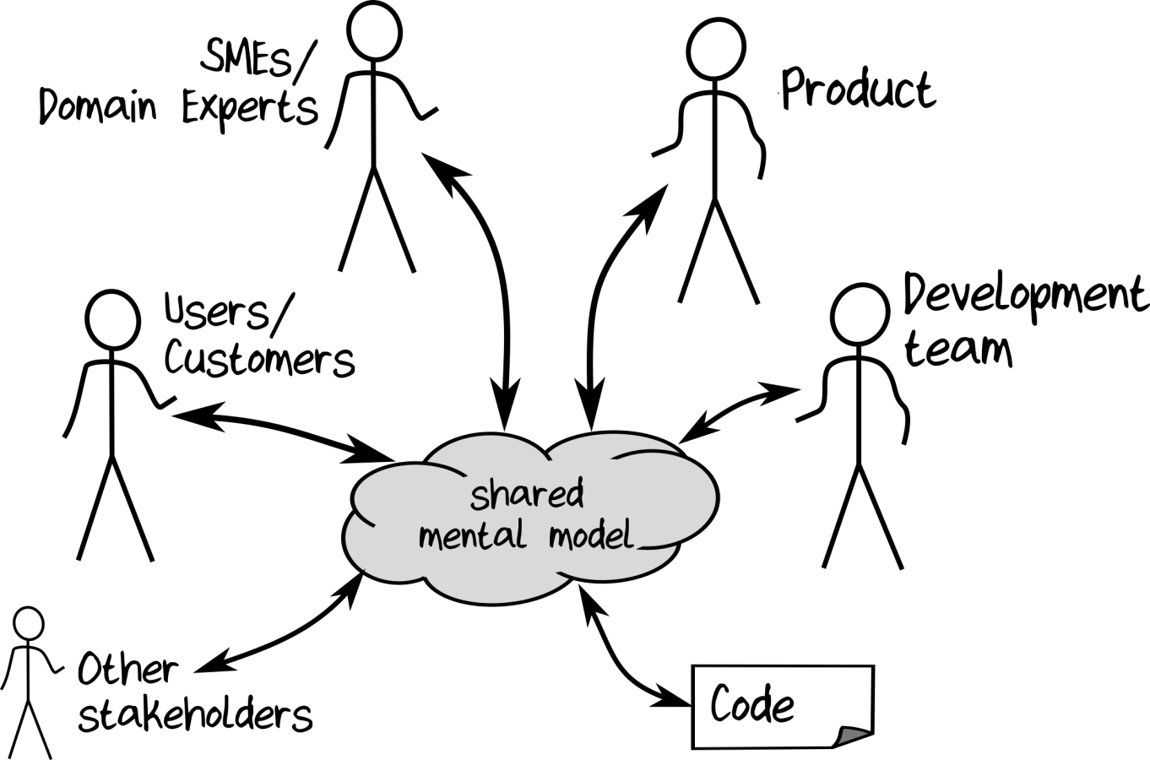
It's not just about creating a document
The process of becoming an expert (building the shared mental model) is important!

Slide 75
Conversation-driven development!

Slide 76
The schedule at a DDD conference...
Time | Description
09:00 presentation | The art of talking to each other
10:00 hands-on | You really should talk to each other more
11:00 workshop | Please, I beg you, stop focusing on tech and just talk to each other
12:00 talk | How to do conversation-driven development
13:00 interview | Our success story: we finally talked to each other
14:00 talk | Report: Our project failed because we didn't talk to each other

Slide 77
How does this kind of domain modelling fit with other DDD techniques?

Slide 78
Ideal development process
Understanding the big picture (event storming, etc)
Partitioning and prioritizing (bounded contexts)
Designing the domain model
Implementation
User testing

Slide 79

actual
Ideal development process
Understanding the big picture (event storming, etc)
Partitioning and prioritizing (bounded contexts)
Designing the domain model
Implementation
User testing

Slide 80
Ideal development process
Understanding the big picture (event storming, etc)
Everyone involved talks to each other here
Partitioning and prioritizing (bounded contexts)
And here
Designing the domain model
Implementation
User testing
And here

Slide 81
Ideal development process
Understanding the big picture (event storming, etc)
Partitioning and prioritizing (bounded contexts)
Everyone is involved here too to build a shared model
Designing the domain model
Implementation
Reinforces the shared language
User testing
e.g. "ShuffledDeck"

Slide 82
Key DDD principle: Communicate the design in the code

Slide 83
A domain modeling challenge!

Slide 84
type Contact = {
FirstName: string
MiddleInitial: string
LastName: string
EmailAddress: string
IsEmailVerified: bool
}
Is the design communicated in this code?
// true if ownership of // email address is confirmed

Slide 85
Prologue: which values are optional?
type Contact = {
FirstName: string
MiddleInitial: string
LastName: string
EmailAddress: string
IsEmailVerified: bool
}
Which values are optional?

Slide 86
Prologue: what are the constraints?
type Contact = {
FirstName: string
MiddleInitial: string
LastName: string
EmailAddress: string
IsEmailVerified: bool
}
Must not be more than 50 chars
What are the constraints?

Slide 87
Prologue: domain logic?
type Contact = {
FirstName: string
MiddleInitial: string
LastName: string
EmailAddress: string
IsEmailVerified: bool
}
What is the domain logic?
Must be reset if email is changed

Slide 88
Prologue: F# can help
type Contact = {
FirstName: string
MiddleInitial: string
LastName: string
EmailAddress: string
IsEmailVerified: bool
}
Which values are optional?
What are the constraints?
Any domain logic?

Slide 89

Not communicating the design in the code

Slide 90
Prologue: F# can help
type Contact = {
FirstName: string
MiddleInitial: string
LastName: string
EmailAddress: string
IsEmailVerified: bool
}
Which values are optional?
What are the constraints?
Any domain logic?
Functional domain modeling CAN communicate all these decisions!

Slide 91
Part III Understanding FP type systems
Why *functional* domain modeling instead of OO domain modeling?

Slide 92
FP principle: Composition everywhere

Slide 93


Slide 94

Composition = Make big things from small things

Slide 95
Algebraic type system
Composable

Slide 96
New types are built from smaller types by:
Composing with “AND”
Composing with “OR”

Slide 97



Compose with “AND”
FruitSalad = One each of and and
A record type
type FruitSalad = {
Apple: AppleVariety
Banana: BananaVariety
Cherry: CherryVariety
}
Another type, the set of all possible apples
All languages have this. Example: pairs, tuples, records

Slide 98
Compose with “OR”
Snack = or or
A choice type
type Snack =
| Apple of AppleVariety
| Banana of BananaVariety
| Cherry of CherryVariety
Again, the set of all possible apples
Not generally available in non-FP languages

Slide 99
A real world example of composing types

Slide 100
Some requirements:
We accept three forms of payment:
Cash, PayPal, or Card.
For Cash we don't need any extra information
For PayPal we need a email address
For Cards we need a card type and card number
How would you implement this?

Slide 101
In OO design you would probably implement it as an interface and a set of subclasses, like this:
interface IPaymentMethod
{..}
class Cash() : IPaymentMethod
{..}
class PayPal(string emailAddress): IPaymentMethod
{..}
class Card(string cardType, string cardNo) : IPaymentMethod
{..}

Slide 102
In FP you would probably implement by composing types, like this:
type EmailAddress = string
type CardNumber = string
Primitive types

Slide 103
type EmailAddress = ...
type CardNumber = …
Choice type (using OR)
type CardType = Visa | Mastercard
type CreditCardInfo = {
CardType : CardType
CardNumber : CardNumber
}
Record type (using AND)

Slide 104
type EmailAddress = ...
type CardNumber = ...
type CardType = ...
type CreditCardInfo = ...
type PaymentMethod =
| Cash
| PayPal of EmailAddress
| Card of CreditCardInfo
Choice type

Slide 105
type EmailAddress = ...
type CardNumber = ...
type CardType = ...
type CreditCardInfo = ...
type PaymentMethod =
| Cash
| PayPal of EmailAddress
| Card of CreditCardInfo
Information associated with that choice

Slide 106
type EmailAddress = ...
type CardNumber = ...
type CardType = ...
type CreditCardInfo = ...
type PaymentMethod =
| Cash
| PayPal of EmailAddress
| Card of CreditCardInfo
Another primitive type
type PaymentAmount = decimal
type Currency = EUR | USD
Another choice type

Slide 107
type EmailAddress = ...
type CardNumber = ...
type CardType = ...
type CreditCardInfo = ...
type PaymentMethod =
| Cash
| PayPal of EmailAddress
| Card of CreditCardInfo
type PaymentAmount = decimal
type Currency = EUR | USD
Record type
type Payment = {
Amount : PaymentAmount
Currency : Currency
Method : PaymentMethod }

Slide 108

Final type built from many smaller types:
type EmailAddress = ...
type CardNumber = ...
type CardType = ...
type CreditCardInfo = ...
type PaymentMethod =
| Cash
| PayPal of EmailAddress
| Card of CreditCardInfo
type PaymentAmount = decimal
type Currency = EUR | USD
Composition ftw!
type Payment = {
Amount : PaymentAmount
Currency : Currency
Method : PaymentMethod }

Slide 109
Part IV Domain modeling with composable types
Let's apply this approach to the "contact" challenge

Slide 110
type Contact = {
FirstName: string
MiddleInitial: string
LastName: string
EmailAddress: string
IsEmailVerified: bool
}
This looks suspiciously like database-driven design...
Let's refactor it to make it domain-driven!
// true if ownership of // email address is confirmed

Slide 111
"A contact has a name AND email info"
type Contact = {
Name: PersonalName
Email: EmailContactInfo }
"Like this?..."

Slide 112
"A contact has a name AND email info"
type Contact = {
Name: PersonalName
Email: EmailContactInfo }
We have two new concepts already!

Slide 113
"What's a personal name?"
type PersonalName = {
FirstName: string
MiddleInitial: string
LastName: string
}

Slide 114
"What's required or optional?"
type PersonalName = {
FirstName: string
MiddleInitial: string
LastName: string
}
required
optional
required
How can we represent optional values?

Slide 115
Modeling optional values

Slide 116
Null is not the same as “optional”
“a” “b” “c”
“a” “b” “c” null
1 2
3
Length string –› int
Type: String

Slide 117
Null is not the same as “optional”
“a” “b” “c” null
1 2
3
Length string –› int
is null really a string?
Type: String
(set of all possible strings)

Slide 118
Null is not allowed
“a” “b” “c” null
1 2
3
Length string –› int
X
null is not allowed as a value!
Type: String

Slide 119
A better way for optional values
Tag these with “SomeString”
“a” “b” “c”
“a” “b” “c”
=
type OptionalString =
| SomeString of string
| Nothing
+
or
missing
Tag with “Nothing”

Slide 120
Defining optional types
type OptionalString =
| SomeString of string
| Nothing
type OptionalInt =
| SomeInt of int
| Nothing
Duplicate code?
type OptionalBool =
| SomeBool of bool
| Nothing

Slide 121
type Option<'T> =
| Some of 'T
| None
Generic type

Slide 122
type Option<'T> =
| Some of 'T
| None
Something
OR
Nothing
A choice type

Slide 123
type PersonalName = {
FirstName: string
MiddleInitial: Option<string>
LastName: string
}

Slide 124
type PersonalName = {
FirstName: string
MiddleInitial: string option
LastName: string
}
nice and readable!

Slide 125
Demo: 01-Options.fsx

Slide 126
Modeling simple values and constrained values

Slide 127
Modeling simple values
Avoid "Primitive Obsession"
Simple values should not be modelled with primitive types like "int" or "string" or "float"
"Does 'float' have something to do with water?"

Slide 128
Modeling constrained values
It's rare to have an unconstrained int or string:
An EmailAddress must not be empty, it must match a pattern
A PhoneNumber must not be empty, it must match a pattern
A CustomerId must be a positive integer

Slide 129
Is an EmailAddress just a string? No!
Is a CustomerId just a int? No!
Can you concat two EmailAddresses to make another valid EmailAddress?
Can you multiply a CustomerId by 42?

Slide 130
Use wrapper types to keep domain concepts distinct from their representation
Wrap a string
type EmailAddress = EmailAddress of string
type CustomerId = CustomerId of int
Wrap an int
A constrained string
type String50 = String50 of string

Slide 131
type EmailAddress = EmailAddress of string
type PhoneNumber = PhoneNumber of string
Distinct types
type CustomerId = CustomerId of int
type OrderId = OrderId of int
Also distinct types
Two benefits:
- Clearer domain modelling
- Can't mix them up accidentally

Slide 132
Implementing constructors for constrained types

Slide 133
let createEmailAddress (s:string) =
if s.Contains("@")
then (EmailAddress s)
else ?
createEmailAddress: string –› EmailAddress
This is a lie!

Slide 134
let createEmailAddress (s:string) =
if s.Contains("@")
then Some (EmailAddress s)
else None
createEmailAddress: string –› EmailAddress option
This is more explicit

Slide 135
type String50 = String50 of string
let createString50 (s:string) =
if s.Length <= 50
then Some (String50 s)
else None
createString50 : string –› String50 option

Slide 136
What’s wrong with this picture?
Qty:
–
999999
+
Add To Cart
How could this happen?

Slide 137
How many people ever do this?
New wrapper type just for this domain
type OrderLineQty = OrderLineQty of int
let createOrderLineQty qty =
if qty > 0 && qty <= 99
then Some (OrderLineQty qty)
else None
createOrderLineQty: int –› OrderLineQty option

Slide 138
Demo: 02-ConstrainedTypes.fsx

Slide 139
The "Contact" challenge, after first refactor

Slide 140
type Contact = {
FirstName: string
MiddleInitial: string
LastName: string
EmailAddress: string
IsEmailVerified: bool
}

Slide 141
Use option type for potentially missing values
type Contact = {
FirstName: string
MiddleInitial: string option
LastName: string
EmailAddress: string
IsEmailVerified: bool
}

Slide 142
Use wrapper types instead of primitives
type Contact = {
FirstName: String50
MiddleInitial: String1 option
LastName: String50
EmailAddress: EmailAddress
IsEmailVerified: bool
}

Slide 143
type PersonalName = {
FirstName : String50
MiddleInitial : String1 option
LastName : String50 }
2 different
domain concepts
type EmailContactInfo = {
EmailAddress : EmailAddress
IsEmailVerified : bool }
Aggregates a.k.a. "consistency boundaries"

Slide 144
Replacing flags with choices

Slide 145
type EmailContactInfo = {
EmailAddress : EmailAddress
IsEmailVerified : bool }
What about this?

Slide 146
type EmailContactInfo = {
EmailAddress : EmailAddress
IsEmailVerified : bool }
But anyone can set this to true
Rule 1: If the email is changed, the verified flag must be reset to false.
Rule 2: The verified flag can only be set by a special verification service

Slide 147
Listen closely to what the domain expert says...
"An email address is either Verified OR Unverified"
So model it as a choice
type EmailContactInfo =
| Unverified of EmailAddress
| Verified of ???

Slide 148
"Email contact info is either Verified OR Unverified"
type EmailContactInfo =
| Unverified of EmailAddress
| Verified of ???
Use a normal email address

Slide 149
"Email contact info is either Verified OR Unverified"
type EmailContactInfo =
| Unverified of EmailAddress
| Verified of ???
Let's ask a domain expert!

Slide 150
Q: Is a verified email different from an unverified email? Are there different business rules?
A: Yes, it must not be mixed up with unverified.
type VerifiedEmail = VerifiedEmail of EmailAddress
Create a wrapper for a verified email address
"there is no problem that can’t be solved by wrapping it in another type"

Slide 151
"Email contact info is either Verified OR Unverified"
type EmailContactInfo =
| Unverified of EmailAddress
| Verified of VerifiedEmail
A different type!

Slide 152
Q: Where do we get Verified emails from?
A: A special verification process
So model it as a function
type VerificationService = (EmailAddress * VerificationHash) –› VerifiedEmail option
You give me this
And I *might* give you this

Slide 153
Q: Are the business rules clear now?
type VerifiedEmail =
VerifiedEmail of EmailAddress
type VerificationService = (EmailAddress * VerificationHash) –› VerifiedEmail option
type EmailContactInfo =
| Unverified of EmailAddress
| Verified of VerifiedEmail

Slide 154
Q: Are the business rules clear now?
type VerifiedEmail =
VerifiedEmail of EmailAddress
type VerificationService = (EmailAddress * VerificationHash) –› VerifiedEmail option
type EmailContactInfo =
| Unverified of EmailAddress
| Verified of VerifiedEmail
To create the unverified case, you can use any email address

Slide 155
Q: Are the business rules clear now?
type VerifiedEmail =
VerifiedEmail of EmailAddress
type VerificationService = (EmailAddress * VerificationHash) –› VerifiedEmail option
type EmailContactInfo =
| Unverified of EmailAddress
| Verified of VerifiedEmail
To create this case, you need to have a VerifiedEmail

Slide 156
type VerifiedEmail =
VerifiedEmail of EmailAddress
type VerificationService = (EmailAddress * VerificationHash) –› VerifiedEmail option
type EmailContactInfo =
| Unverified of EmailAddress
| Verified of VerifiedEmail
The only way to get a VerifiedEmail is to use the verification service!
Those business rules are automatically enforced by the design!

Slide 157
Demo: 03-RefactoringFlags.fsx

Slide 158
The "Contact" challenge, completed

Slide 159
Before redesign
type Contact = {
FirstName : string
MiddleInitial : string
LastName : string
EmailAddress : string
IsEmailVerified: bool
}
// true if ownership of // email address is confirmed
Looks suspiciously like database-driven design

Slide 160
After redesign
type EmailAddress = ...
type VerifiedEmail =
VerifiedEmail of EmailAddress
type EmailContactInfo =
| Unverified of EmailAddress
| Verified of VerifiedEmail
type PersonalName = {
FirstName: String50
MiddleInitial: String1 option
LastName: String50 }
type Contact = {
Name: PersonalName
Email: EmailContactInfo }

Slide 161
type EmailAddress = ...
type VerifiedEmail =
VerifiedEmail of EmailAddress
type EmailContactInfo =
| Unverified of EmailAddress
| Verified of VerifiedEmail
type PersonalName = {
FirstName: String50
MiddleInitial: String1 option
LastName: String50 }
type Contact = {
Name: PersonalName
Email: EmailContactInfo }
Which values are optional?
Which fields are linked?
What are the constraints?
Domain logic clear?

Slide 162
type EmailAddress = ...
type VerifiedEmail =
VerifiedEmail of EmailAddress
type EmailContactInfo =
| Unverified of EmailAddress
| Verified of VerifiedEmail
type PersonalName = {
FirstName: String50
MiddleInitial: String1 option
LastName: String50 }
type Contact = {
Name: PersonalName
Email: EmailContactInfo }
Which values are optional?

Slide 163
type EmailAddress = ...
type VerifiedEmail =
VerifiedEmail of EmailAddress
type EmailContactInfo =
| Unverified of EmailAddress
| Verified of VerifiedEmail
type PersonalName = {
FirstName: String50
MiddleInitial: String1 option
LastName: String50 }
type Contact = {
Name: PersonalName
Email: EmailContactInfo }
What are the constraints?

Slide 164
type EmailAddress = ...
type VerifiedEmail =
VerifiedEmail of EmailAddress
type EmailContactInfo =
| Unverified of EmailAddress
| Verified of VerifiedEmail
type PersonalName = {
FirstName: String50
MiddleInitial: String1 option
LastName: String50 }
type Contact = {
Name: PersonalName
Email: EmailContactInfo }
Which fields are linked?

Slide 165
type EmailAddress = ...
type VerifiedEmail =
VerifiedEmail of EmailAddress
type EmailContactInfo =
| Unverified of EmailAddress
| Verified of VerifiedEmail
type PersonalName = {
FirstName: String50
MiddleInitial: String1 option
LastName: String50 }
type Contact = {
Name: PersonalName
Email: EmailContactInfo }
Domain logic clear?

Slide 166
type EmailAddress = ...
type VerifiedEmail =
VerifiedEmail of EmailAddress
type EmailContactInfo =
| Unverified of EmailAddress
| Verified of VerifiedEmail
type PersonalName = {
FirstName: String50
MiddleInitial: String1 option
LastName: String50 }
type Contact = {
Name: PersonalName
Email: EmailContactInfo }
The domain language is evolving along with the design
And all this is compilable code, of course

Slide 167
Refactoring towards deeper insight

Slide 168
Refactoring towards deeper insight
Business rule: Only send password resets to verified emails
let sendPasswordReset (info:EmailContactInfo) = // if EmailContactInfo.IsVerified then
// logic to send password reset
// else
// error
Unclear what the logic is. We need to look at the documentation

Slide 169
Refactoring towards deeper insight
Business rule: Only send password resets to verified emails
type VerifiedEmail = ...
We learned a new concept which is applicable to other workflows

Slide 170
Refactoring towards deeper insight
Business rule: Only send password resets to verified emails
type VerifiedEmail = ...
let sendPasswordReset (email:VerifiedEmail) =
// logic to send password reset
// (boolean test no longer needed)
Better documentation and safer too!

Slide 171
Part V Encoding business rules with types

Slide 172
type Contact = { Name: Name Email: EmailContactInfo Address: PostalContactInfo
}
New! Added as the design evolves.

Slide 173
New rule: “A contact must have an email or a postal address”
type Contact = { Name: Name Email: EmailContactInfo Address: PostalContactInfo
}
Doesn't meet new requirements

Slide 174
New rule: “A contact must have an email or a postal address”
type Contact = { Name: Name Email: EmailContactInfo option Address: PostalContactInfo option
}
Doesn't meet new requirements either
Could both be missing?

Slide 175
"Make illegal states unrepresentable!" – Yaron Minsky

Slide 176
“A contact must have an email or a postal address”
implies:
email address only, or
postal address only, or
both email address and postal address
only three possibilities
and note the use of "OR"

Slide 177
“A contact must have an email or a postal address”
type ContactInfo =
| EmailOnly of EmailContactInfo
| AddrOnly of PostalContactInfo
| EmailAndAddr of EmailContactInfo * PostalContactInfo
type Contact = { Name: Name ContactInfo : ContactInfo }
requirements are now encoded in the type!
Only three possibilities. You cannot make a mistake.

Slide 178

Composable types are almost as awesome as this

Slide 179
Collaboration is two-way. It's OK to push back

Slide 180
“A contact must have an email or a postal address”
Is this really what the business wants?
This implementation is too rigid
“A contact must have at least one way of being contacted”
Better

Slide 181
“A contact must have at least one way of being contacted”
type ContactInfo =
| Email of EmailContactInfo
| Addr of PostalContactInfo
Way of being contacted
One way of being contacted is required
type Contact = { Name: Name PrimaryContactInfo: ContactInfo SecondaryContactInfo: ContactInfo option }

Slide 182
This design is better because it can evolve more easily
type ContactInfo =
| Email of EmailContactInfo
| Addr of PostalContactInfo
| Facebook of FacebookInfo
| SMS of PhoneNumber
| Twitter of TwitterId
| Skype of SkypeId

Slide 183
Demo 04-DesignExamples.fsx

Slide 184
Part VI: States and Transitions
Modelling a common scenario

Slide 185
States and transitions
Transition from A to B
State A
State B
State C
Transition from B to C
Transition from B to A

Slide 186
States and transitions for email address
Unverified EmailAddress
Verified EmailAddress
Verified
Each state can have different behavior
Rule: "You can only send a verification message to an unverified email"
Rule: "You can only send a password reset message to a verified email "

Slide 187
States and transitions for deliveries
Send out for delivery
Undelivered
Out for delivery
Delivered
Signed for
Address not found
Redeliver
Failed Delivery
Rule: "You can't put a package on a truck if it is already out for delivery"
Rule: "You can't sign for a package that is already delivered"

Slide 188
States and transitions for chess game
White to play
White plays and wins
Black plays
Game Over
White plays
Black to play
Black plays and wins
Rule: “White and Black take turns playing. White can’t play if it is Black’s turn and vice versa"
Rule: “No one can play when the game is over"

Slide 189
States and transitions for shopping cart
Add Item
Add Item
Empty Cart
Active Cart
Paid Cart
Pay
Remove Item
Remove Item
Rule: "You can't remove an item from an empty cart"
Rule: "You can't change a paid cart"
Rule: "You can't pay for a cart twice"

Slide 190
States and transitions for shopping cart
Add Item
Add Item
Empty Cart
Active Cart
Paid Cart
Pay
no data needed
Remove Item
Remove Item
type ActiveCartData = { UnpaidItems: Item list }
type PaidCartData = { PaidItems: Item list; Payment: Payment}
What data do we need to store?

Slide 191
Add Item
Add Item
Empty Cart
Active Cart
Paid Cart
Pay
type ActiveCartData = { UnpaidItems: Item list }
type PaidCartData = { PaidItems: Item list; Payment: Payment}
type ShoppingCart =
| EmptyCart // no data
| ActiveCart of ActiveCartData
| PaidCart of PaidCartData
Remove Item
Remove Item
One of three states
No data needed for empty cart state

Slide 192
Add Item
Add Item
Empty Cart
Active Cart
Paid Cart
Shopping Cart API
Pay
Remove Item
Remove Item
initCart : Item –› ShoppingCart
addToActive: (ActiveCartData * Item) –› ShoppingCart
removeFromActive: (ActiveCartData * Item) –› ShoppingCart
pay: (ActiveCartData * Payment) –› ShoppingCart
might be empty or active – can’t tell

Slide 193
Client code to add an item using the API
let addItem cart item =
match cart with
| EmptyCart –›
Api.initCart item
| ActiveCart activeData –›
Api.addToActive(activeData,item)
| PaidCart paidData –›
Api.???
Cannot accidentally alter a paid cart!
"make illegal operations impossible"

Slide 194
Client code to remove an item using the API
let removeItem cart item =
match cart with
| EmptyCart –›
???
| ActiveCart activeData –› Api.removeFromActive(activeData,item)
| PaidCart paidData –›
???
Compiler will not let you remove from an empty cart!
"make illegal operations impossible"

Slide 195
Demo 05-ShoppingCart.fsx

Slide 196
Why design with state transitions?
Each state can have different allowable data.
All states are explicitly documented.
All transitions are explicitly documented.
It is a design tool that forces you to think about every possibility that could occur.
Put on truck
Undelivered
Out for delivery
Delivered
Signed for
Address not found

Slide 197
Part VII: Total functions
Making contracts explicit

Slide 198
A total function is where every input has an output
input
output

Slide 199
A partial function is where some inputs do NOT have an output
input
output

Slide 200
Yes, it is a bit contrived!
int
int twelveDividedBy(int input)
{
switch (input)
{
case 3: return 4;
case 2: return 6;
case 1: return 12;
case 0: return ??;
}
}
int
…
3
2
1
0
…
…
4
6
12
…
twelveDividedBy(x) input x maps to 12/x

Slide 201
int
int twelveDividedBy(int input)
{
switch (input)
{
case 3: return 4;
case 2: return 6;
case 1: return 12;
case 0: return ??;
}
}
int
…
3
2
1
0
…
…
4
6
12
…
twelveDividedBy(x) input x maps to 12/x
What happens here?

Slide 202
The set of all valid inputs
int
int twelveDividedBy(int input)
{
switch (input)
{
case 3: return 4;
case 2: return 6;
case 1: return 12;
case 0: throw InvalidArgException;
}
}
int
…
3
2
1
0
…
…
4
6
12
…
twelveDividedBy(x) input x maps to 12/x
You tell me you can handle 0, and then you complain about it?

Slide 203
✗
This type signature is a lie!
int -> int
int
int twelveDividedBy(int input)
{
switch (input)
{
case 3: return 4;
case 2: return 6;
case 1: return 12;
case 0: throw InvalidArgException;
}
}
int
…
3
2
1
0
…
…
4
6
12
…
twelveDividedBy(x) input x maps to 12/x

Slide 204
So how can we make a total function?
And make a non-lying signature

Slide 205
One way to make total functions is to constrain the input
NonZeroInteger
int
…
3
2
1
-1
…
int twelveDividedBy(int input)
{
switch (input)
{
case 3: return 4;
case 2: return 6;
case 1: return 12;
case -1: return -12;
}
}
…
4
6
12
…
twelveDividedBy(x) input x maps to 12/x
0 is missing from input
So 0 doesn’t have to be handled!

Slide 206
✓
This is not a lie! (Types as documentation)
NonZeroInteger -> int
NonZeroInteger
int
…
3
2
1
-1
…
int twelveDividedBy(int input)
{
switch (input)
{
case 3: return 4;
case 2: return 6;
case 1: return 12;
case -1: return -12;
}
}
…
4
6
12
…
twelveDividedBy(x) input x maps to 12/x

Slide 207
Another approach is to extend the output
int
int option
…
3
2
1
0
-1
…
int twelveDividedBy(int input)
{
switch (input)
{
case 3: return Some 4;
case 2: return Some 6;
case 1: return Some 12;
case 0: return None;
}
}
…
Some 4
Some 6
Some 12
None …
twelveDividedBy(x) input x maps to 12/x
But "None" is returned in that case
0 is valid input

Slide 208
✓
This is not a lie! (Types as documentation)
int -> int option
int
int option
…
3
2
1
0
-1
…
int twelveDividedBy(int input)
{
switch (input)
{
case 3: return Some 4;
case 2: return Some 6;
case 1: return Some 12;
case 0: return None;
}
}
…
Some 4
Some 6
Some 12
None …
twelveDividedBy(x) input x maps to 12/x

Slide 209
Total functions are more explicit
// not total
int -> int
// constrained input
NonZeroInteger -> int
// extended output
int -> int option

Slide 210
Explicit contracts mean fewer bugs
// not total
int -> int
// constrained input
NonZeroInteger -> int
// extended output
int -> int option
Could cause runtime error if you don't read the docs.
These can NEVER cause runtime errors.

Slide 211
Constrained input vs Extended output
Examples of extended output
// construct constrained types
string -> EmailAddress option
int -> OrderLineQty option
Examples of constrained input
// send a password reset
VerifiedEmail -> ... // pay for a cart
ActiveCart * Payment -> ...

Slide 212
Demo: 06-TotalFunctions.fsx

Slide 213
Summary and Conclusion

Slide 214
Domain-driven design
Represent the shared mental model in code
The developers should become domain experts too
Write code collaboratively to build the shared mental model
Designs will evolve
Embrace change. This is not Big Design Up Front
Refactor towards deeper insight
Static types give you confidence to make changes

Slide 215
Coding Guidelines
Build a domain model with composable types
Use choices rather than inheritance
Use constrained types
Avoid boolean flags
Make illegal states unrepresentable
Uses state machines
Use total functions and explicit contracts
All these approaches improve documentation and make it harder to have errors

Slide 216

Thanks!
Slides and code: github.com/swlaschin/DmmfWorkshop_2hr
More at fsharpforfunandprofit.com/ddd
Training in a few weeks! https://www.avanscoperta.it/en/training/
Twitter: @ScottWlaschin

